Slide 1

StealthyIMU: Extracting Permission-protected Private Information from Smartphone Voice Assistant using Zero-Permission Sensors
Ke Sun, Chunyu Xia, Songlin Xu, Xinyu Zhang
University of California, San Diego
NDSS’23, Mar 1st, 2023

Slide 2

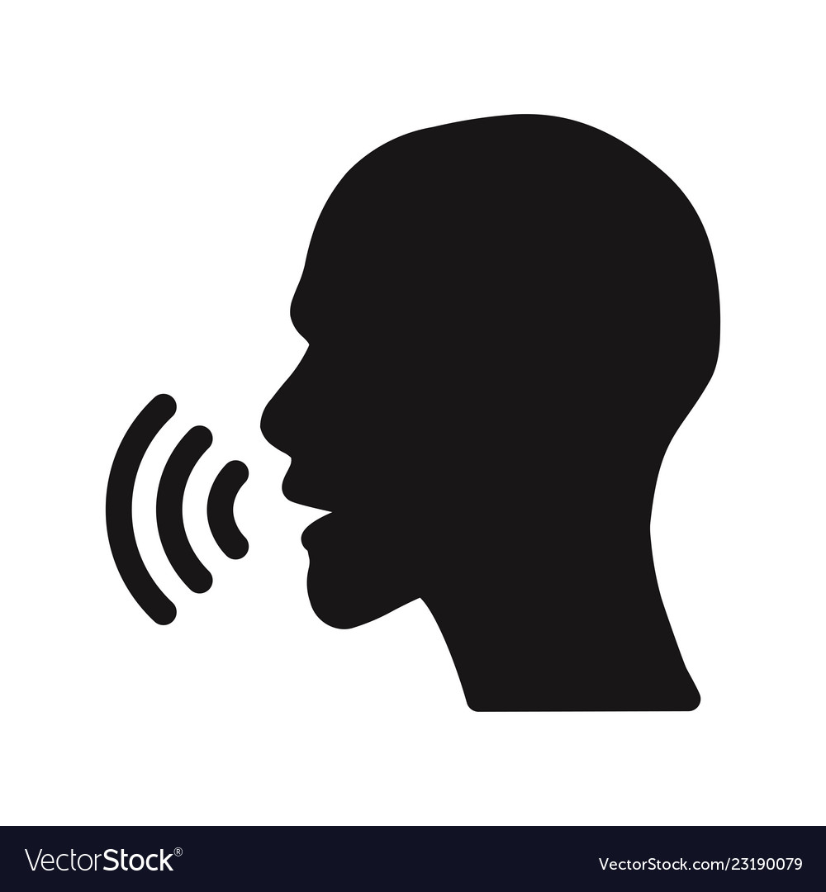

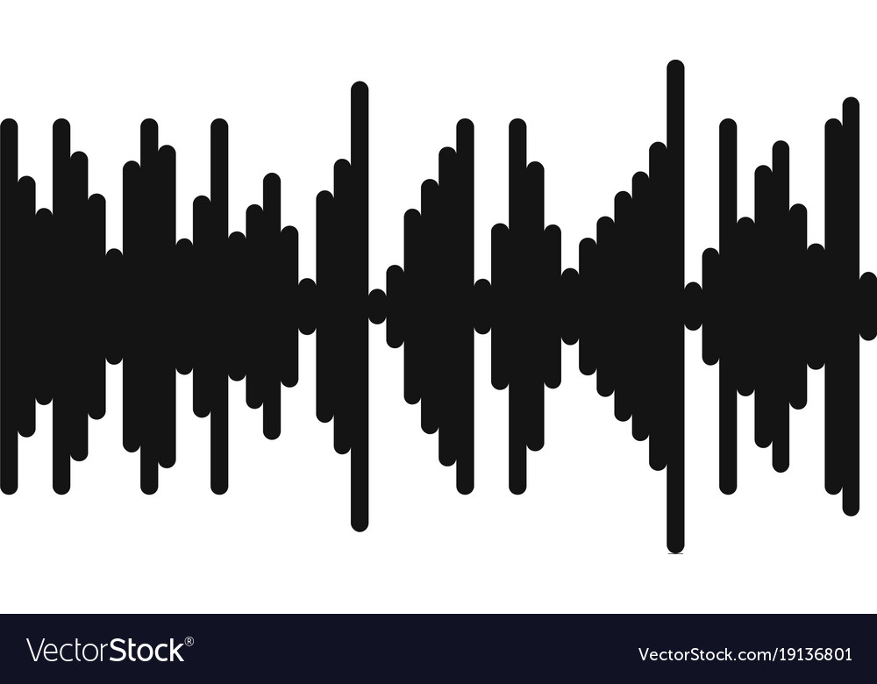



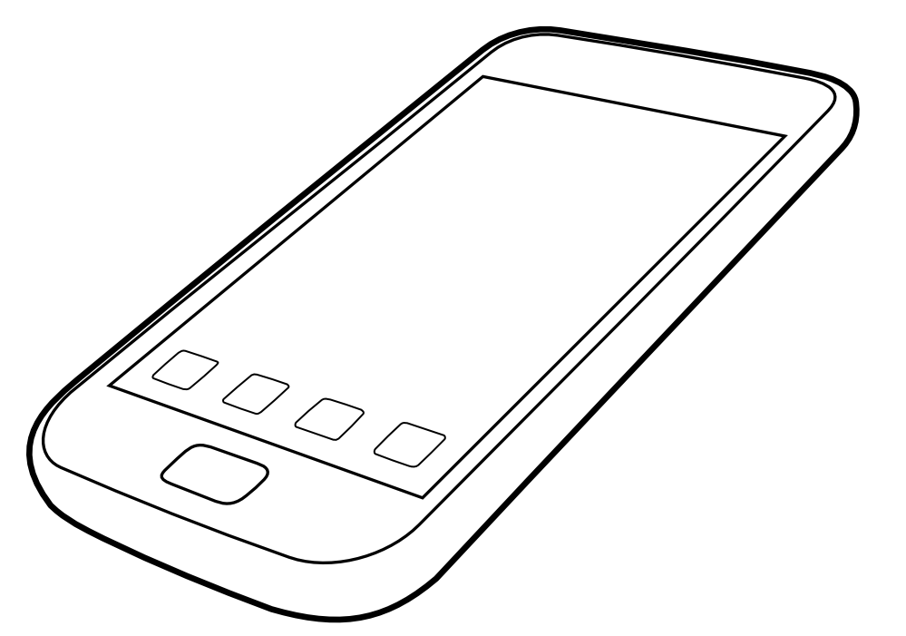



Speech Eavesdropping on Smartphone
Motion Sensor Signals
(MSS)
Motion Sensor
No permission required
Victim
Permission required
Attacker
Microphone
Only loudspeaker-rendered speech signals traveling through a solid surface can create noticeable impacts on motion sensors [1].
[1] Speechless: Analyzing the threat to speech privacy from smartphone motion sensors, S&P’18
Notes:
Traditionally, adversaries can use the microphone on the smartphone to eavesdrop on the victim.
However, the microphone permission has been protected by the smartphone OS permission.
In comparison, the motion sensors are zero-permission sensors, which are accessible by any app on the mainstream mobile OS to facilitate applications like Auto-rotate screen. Recently some papers show that they can potentially create a side channel to eavesdrop on the speech of the victim by capturing the vibration induced by speech signals. However, recent research found that only loudspeaker-rendered speech signals traveling through a solid surface can create noticeable impacts on motion sensors. Therefore, the threat of such a side-channel eavesdropping attack is not that significant since it can only capture the speech from the loudspeaker.

Slide 3
Limitations of Prior works
Achieve low-risk task
Classifying a small set of digits and hot words [2,3]
Partially recover the speech signals [4]
Motion Sensor:
Low sampling rate (<= 500 Hz)
Low Signal-to-Noise Ratio (SNR)
Additional interference
In ideal scenario
Small number of users in the dataset (<20 users) [2][3][4]
Training and testing with the same group of users [2][3][4]
[2] Learning-based practical smartphone eavesdropping with built-in accelerometer, NDSS’20
[3] Spearphone: a lightweight speech privacy exploit via accelerometer-sensed reverberations from Smartphone loudspeakers, WiSec’21
[4] AccEar: Accelerometer Acoustic Eavesdropping with Unconstrained Vocabulary, S&P’22
Notes:
Besides, since the motion sensors are not designed for speech eavesdropping. They also have a limited low sampling rate, low SNR, and additional interference compared to the microphone. This results in that they can only capture the fundamental frequency of human speech less than 250 Hz and has low SNR and large interference.

Slide 4

Will this threat model pose a real privacy threat to victims?
Loudspeaker
Motion Sensor
No permission required
Victim
Attacker
Extracting Permission-protected Private Information from Smartphone Voice-User Interface (VUI) responses.

Slide 5




StealthyIMU Threat Analysis
Reading permissions granted by VUI app
Calendar
Contacts
Locations
Search history
Alarm
Reminder
Phone
SMS
Voicemail
Billing
etc
Voice Assistant responses
contain the permission-protected
private information.
Motion Sensor
No permission required
Attacker

Slide 6
StealthyIMU Threat Model
Apple Siri,
Google Assistant
Set a reminder to check my bank account XXXX.
Got it, check
bank account XXXX.
Motion Sensor
Victim
No permission required
Type: Reminder
Intents:
Check bank account
XXXX
Attacker

Slide 7
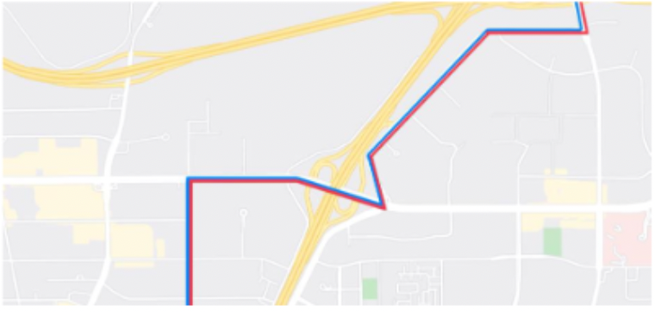
StealthyIMU Threat Model
In 600 feet use the right
lane to turn right onto
Hollywood Boulevard.
Type: Navigation
Intents:
Turn right
Names:
Hollywood Boulevard
Motion Sensor
No permission required
Attacker
GPS Trace

Slide 8
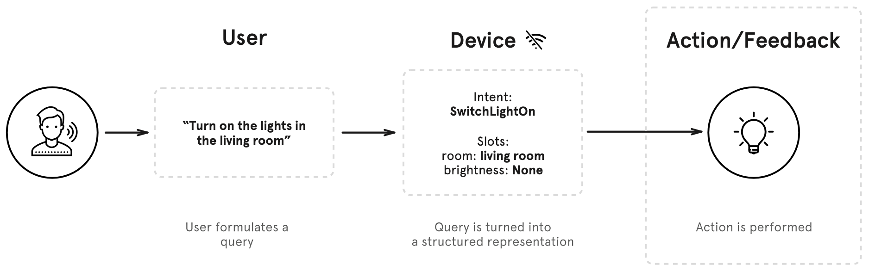
Inferring privacy from a single VUI response: problem statement
Traditional Spoken Language Understanding (SLU) system for VUI
[5] Snips Voice Platform: an embedded Spoken Language Understanding system for private-by-design voice interfaces

Slide 9
Comparison between SLU for VUI and StealthyIMU
 | SLU for VUI | SLU for StealthyIMU
Goal | Extract the request from speech | Extract the privacy from VUI response induced MSS
Captured Signals | Microphone High sampling rate High speech quality | Motion Sensor Low sampling rate Low speech quality
Type of Voices | Human subjects: Arbitrary # of voices profiles | Machine-rendered: Limited # of voices profiles
Type of Speech | VUI requests: Arbitrary format | VUI responses: More deterministic format

Slide 10
Attacking Requirements and Targets
Targeted permissions:
Read calendar
Read contacts, SMS
Read search history
Access coarse location
Access GPS trace
etc.
Affordable Attack
High attacking success rate
Explicit permission-protected private information extraction

Slide 11


Challenge 1: how to achieve affordable attack?
Neither the smartphone OS nor the user can notice the attack.
Real-time Detect, Segment, Identify the VUI responses
Process the MSS and extract the
on the cloud
MSS Streaming
Low on-device computational cost
Real-time two-stage detection algorithm → < 5% Peak CPU Usage
Lightweight voice identification DNN models. → 79.6 KB model size
Low on-device storage cost
Only save the potential MSS → 16 kB/ response
Low communication requirement
Only upload the private information → less than 50 bytes/ response

Slide 12
Challenge 2: Inferring Privacy from a Single VUI response → SLU model design
Type: Reminder
Intents:
Check bank account
1234
ASR
Got it, check
bank account 1234.
NLU
MSS Streaming
However, due to the low sampling rate and low speech quality, the first stage, i.e., ASR, can only achieve low accuracy.

Slide 13
End-to-end SLU Model
Type: Reminder
Intents:
Check bank account
1234
End-to-end
SLU
MSS Streaming
The format of VUI response is deterministic.
Only need to extract the private information while ignoring other information.

Slide 14
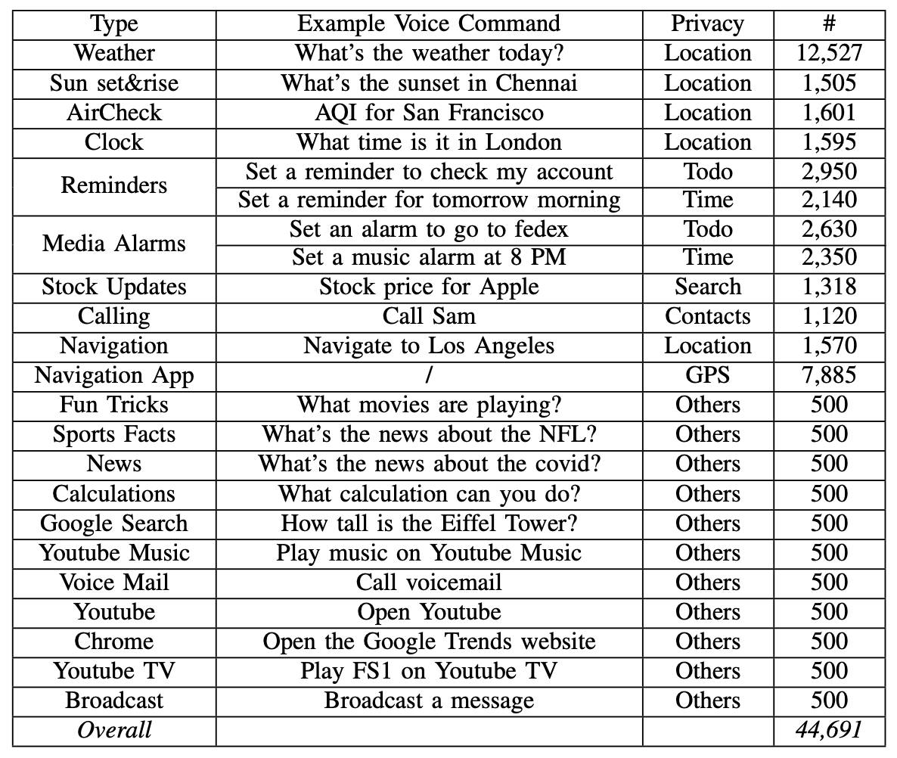
VUI Commands Generation
44,691 different VUI commands
23 types of VUI commands
Analysis the format and structures of VUI response, and then manually label them (1,000 hours to label 100 hours data).
Open-sourced dataset and code: https://github.com/Samsonsjarkal/StealthyIMU

Slide 15
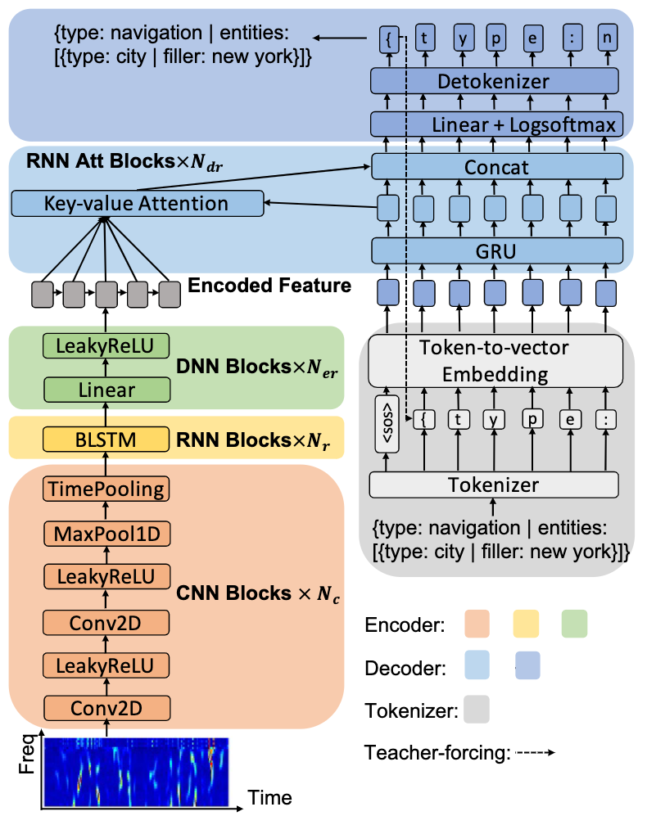
SLU Model Design
End-to-end SLU model
Seq-to-seq model
Encoder + Decoder design
Sub-word level Tokenizer
Teacher-forcing
How to improve the performance through crossmodal data?

Slide 16
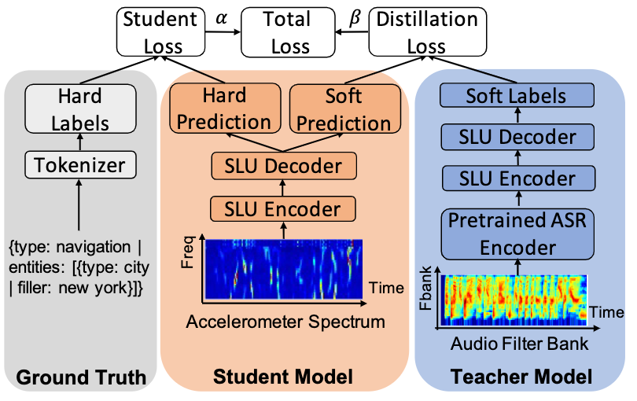
Knowledge Distillation from Speech-based SLU
Speech-based SLU achieves significantly better performance than the MSS-based.
Use the knowledge from the Speech-based SLU to help the training of the MSS-based SLU.

Slide 17
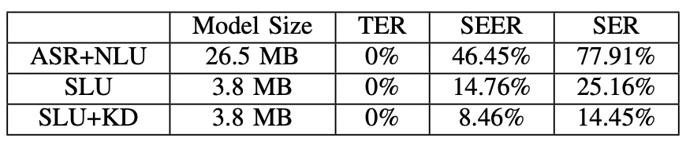
Evaluation: VUI Response Private Entity Recognition
Evaluation metrics:
TER: Type Error Rate
SEER: Single Entity Error Rate
SER: Sentence Error Rate → only if all the entities in a single VUI response are recognized correctly
Lower TER, SEER, SER means better performance.
SLU model significantly outperforms the traditional ASR + NLU solution.
Knowledge distillation from speech signals can help

Slide 18
Challenge 3: Extract the Explicit Permission-protected Privacy
Combining the private intents from single or multiple VUI responses.
One-time Stealing
Short-term Contextual Inference
Long-term Monitoring

Slide 19
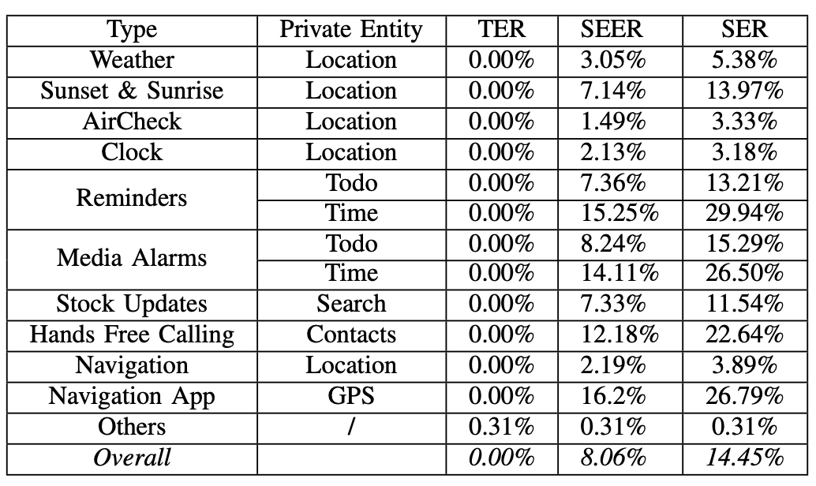
One-time Stealing
Take a single VUI response as the input to extract privacy information.
An average 85.28% success rate
Voice commands like
Reminders
Media Alarm
Hands Free Calling
Navigation App
has complicated response formats resulting in relatively low success rate (> 70%).

Slide 20
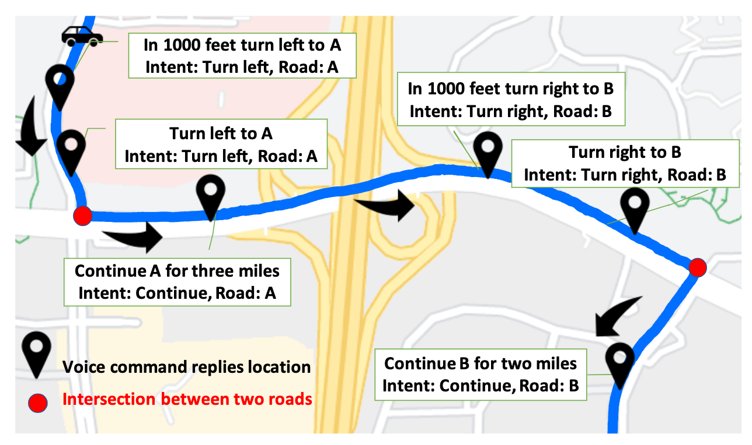
Short-term Contextual Inference
Infer private information using multiple consecutive VUI responses.
Example: Navigation app to recover GPS trace

Slide 21
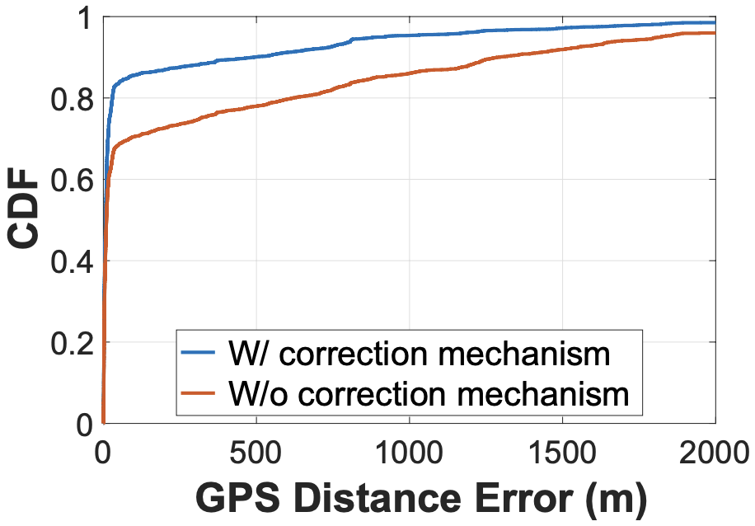
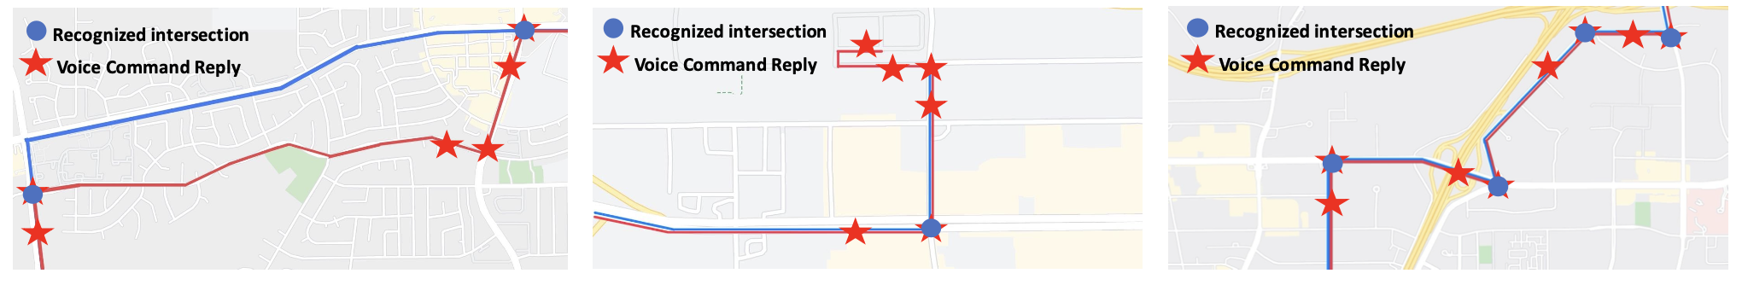
Short-term Contextual Inference
GPS trace recovery algorithm:
average/max deviation is 133 m/420 m

Slide 22
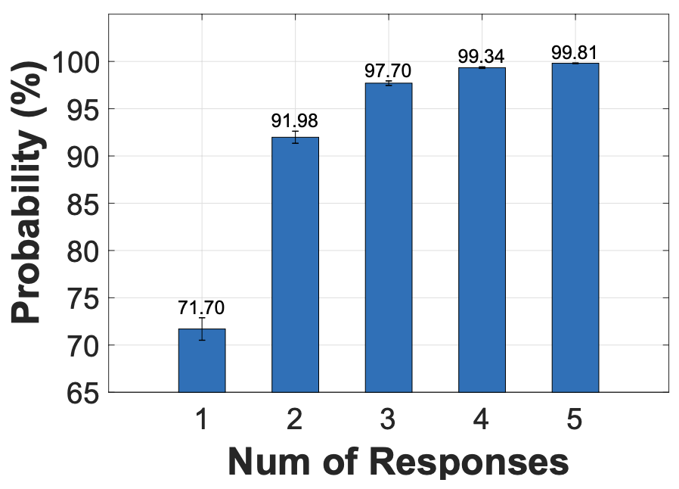
Long-Term Monitoring
Repeat the same type of voice commands in a few days, like check weather, air quality, reminder, and navigate home, etc.
Assumption: each VUI response is a single individual event.
Extract the city name from daily weather VUI response.
Identify the city name increases from 70% (1 inquiry) to above 98% (3+ inquiries).

Slide 23
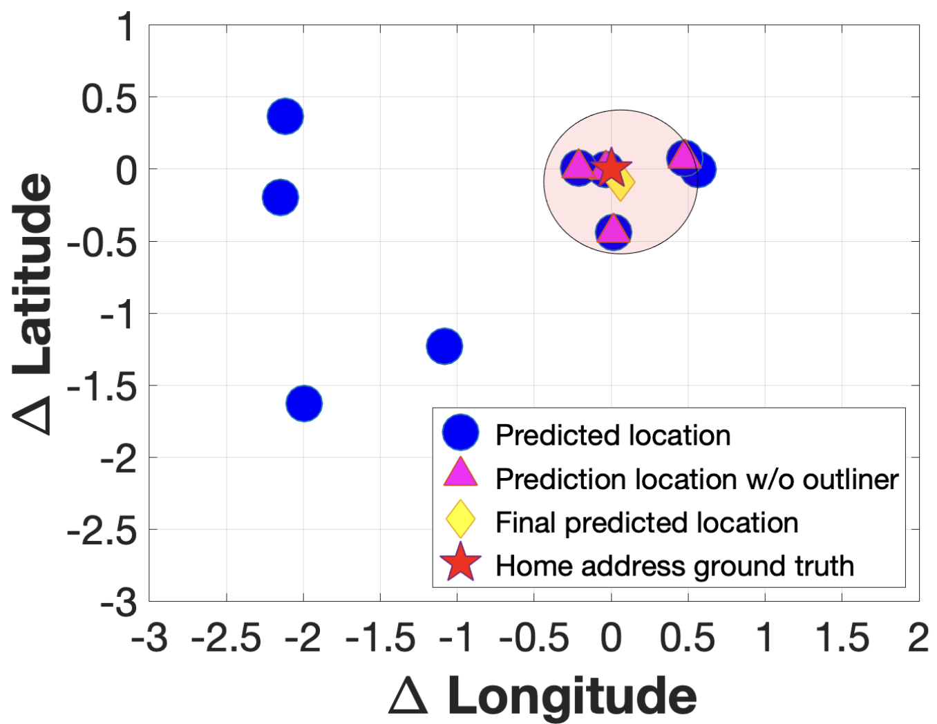
Long-term Monitoring
Extract the home address from daily navigation back to home.
Achieves 11 meters home address estimation error by combining 10 attempts.

Slide 24
Conclusion
Uses zero-permission motion sensors to extract permission-protected private information from VUI responses.
Affordable attack vector.
Formulate it to SLU problem, use cross-modal knowledge distillation strategy to extract the private entities.
Short-term and long-term attack to steal user calendar, search history, GPS trace, home address, etc.
Speech pre-distortion defense mechanism.
StealthyIMU will be general to use other side channels, like RF, light, etc, to steal the private information from other VUI devices.

Slide 25
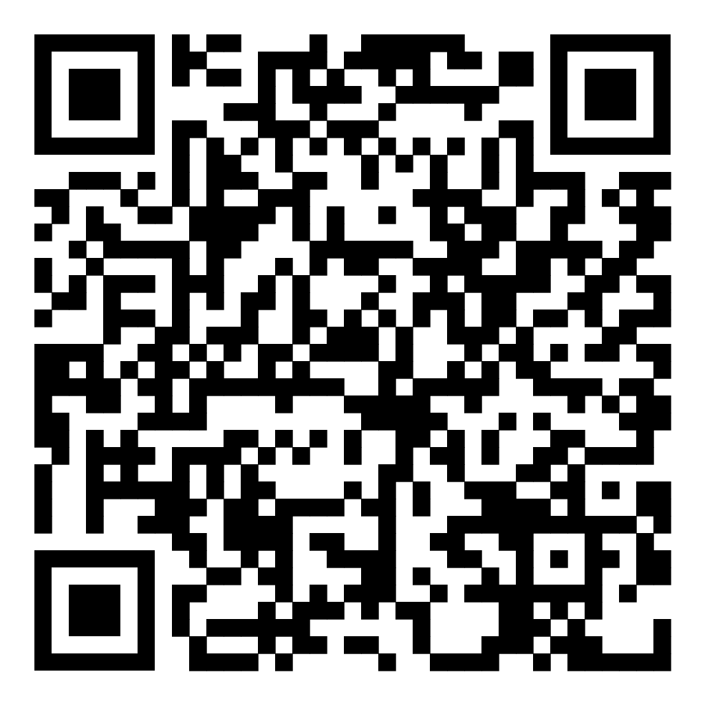
Thank you
Q&A
https://github.com/Samsonsjarkal/StealthyIMU

Slide 26
StealthyIMU Attacking Pipeline
“Network in the background” permission, 100 KB/min
Attacker
Process the MSS, extract the privacy
on the cloud
“Storage in the memory” permission, 100 KB/min
“Network” permission
Attacker
MSS Streaming
Process the MSS
on device
“Storage in the app” permission, 16 kB/ response
“Network” permission
Real-time Detect, Segment, Identify the VUI responses
Attacker
Process the MSS
on device

Slide 27
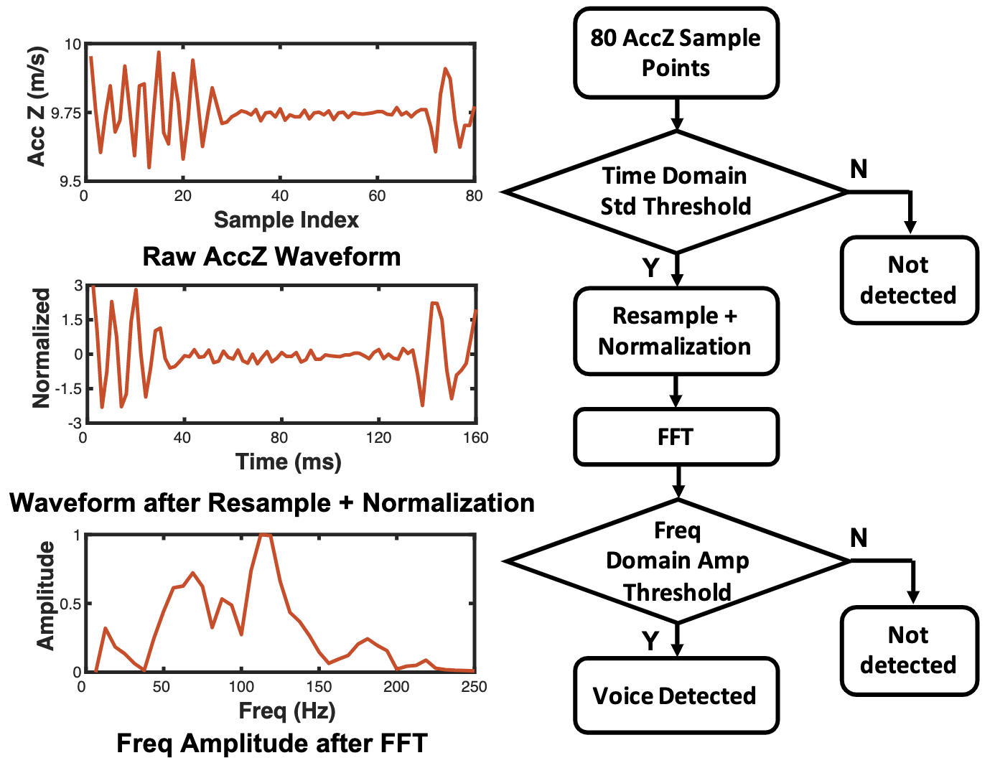
Real-time Detect, Segment VUI Responses
Two-stage detection
Stage 1: Lightweight detection
15 mW, 2% CPU
Stage 2: Resample + FFT + detection
35 mW, 5% CPU
Segmentation
2~8 s duration for each VUI response
16 KB per VUI response

Slide 28
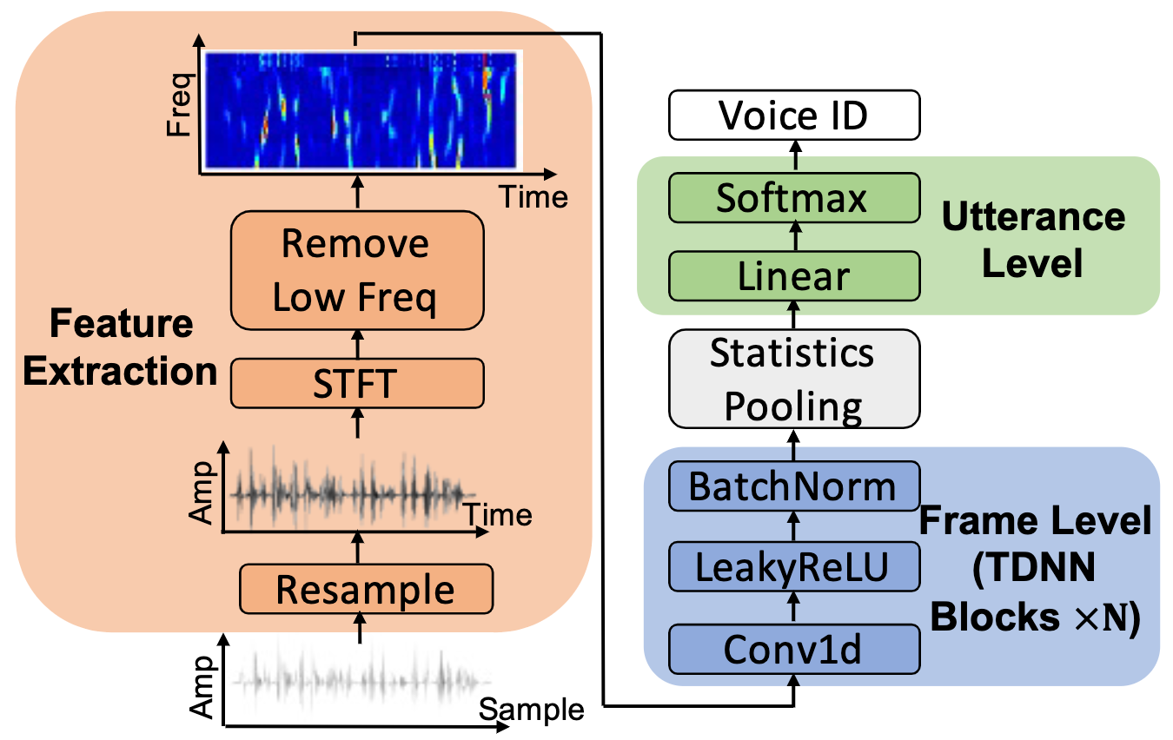
Offline Identify VUI Responses
Motivation: Identify the VUI response-induced MSS.
Assumption: VUIs only has a limited set of voice profiles.
Solution: Lightweight voice identification DNN models.

Slide 29
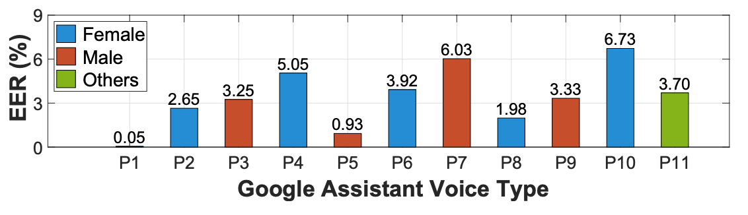
Evaluation: Detect, Segment, and Identify VUI Responses
Equal Error Rate (EER) → both acceptance and rejection errors are equal.
An average 3.5% EER for different voices
 | Mobile Data | Segment Memory | Peak CPU | Power
Cloud-based attack | 100 KB/min | / | / | /
StealthyIMU | / | 16 KB/Seg | 5% | 35mW

Slide 30






MSS and Corresponding Speech Collection
Set a reminder to check my bank account XXXX.
Text-to-speech
$$Q_{i}$$
Motion Sensor
$$M_{i}$$
ASR
Label
Bank account: XXXX
Microphone
$$S_{i}$$

Slide 31
Extract the Ground Truth Private Entities
Intents:
Name:
Turn left/ right
Take the next left/ right
Slight left/ right
Keep left/ right
Continue
Stay
Take (highway and exit)
Towards
Make a U-turn
Merge
Follow sign
Arrive at destination
Road
Highway
Exit name
Use the right lane to take exit 1b toward B drive then turn left onto C street Type: navigation Entities: type: intent | filler: take, type: name | filler: exit 1b;
type: intent | filler: towards, type: road | filler: B drive;
type: intent | filler: turn left, type: name | filler: C street;

Slide 32
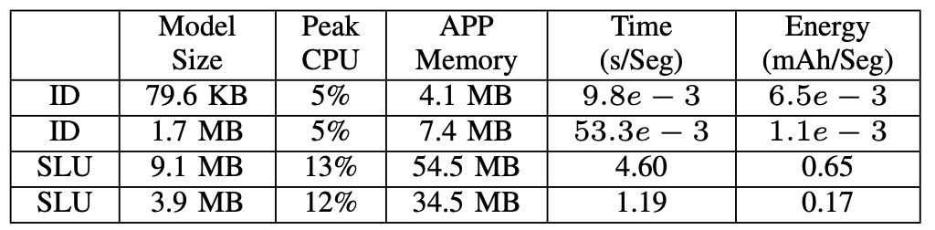
Evaluation: VUI Response Private Entity Recognition
Our SLU model can recognize 176 voice-associated segments with less than 1% battery consumption.

Slide 33
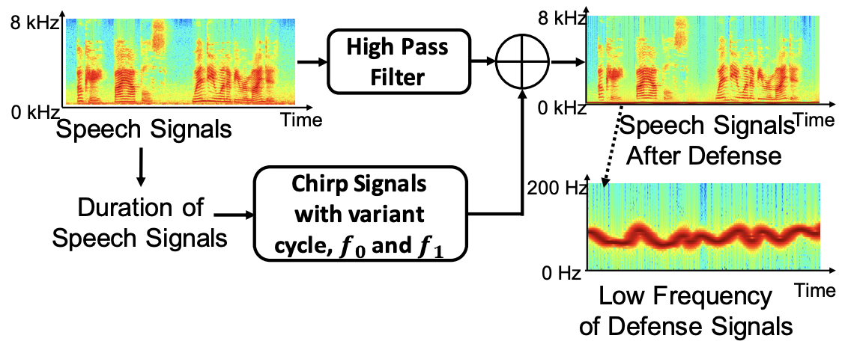
Defense
Predistortion of Speech Signals
Assumption: the highest MSS sampling rate < 500 Hz
Insight: modifying the low modifying the low-frequency components of speech signals
Will significantly impact the MSS.
Will not affect the human perceivable speech quality.

Slide 34
Defense
Redesigning the Permissions
If vendors unleash the sampling rate limitation to 4000 Hz
Even if future smartphone OS restricts the motion sensor permission, the StealthyIMU attack can still work—it can pretend to be an innocuous app that needs the motion sensor permission alone.

Slide 35
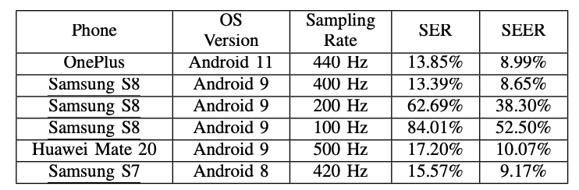
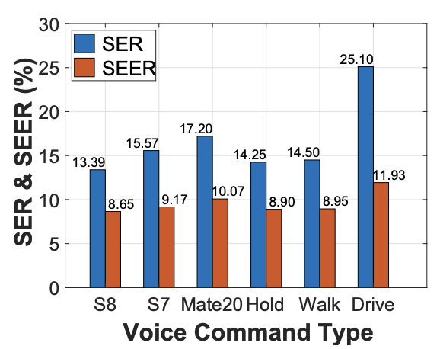
Evaluation: Generalization
Different Sampling Rate, Smartphone models
Different Motion Artifacts Interference

Slide 36
Evaluation: Implementation & Overhead
Attack Implementation:
Process the MSS, extract the privacy
on the cloud
MSS Streaming
Real-time Detect, Segment, Identify the VUI responses
Process the MSS and extract the
on the cloud
Voice detection and segmentation overhead (running in the background)
 | Mobile Data | Segment Memory | Peak CPU | Power
1 | 100 KB/min | / | / | /
2 | / | 16 KB/Seg | 5% | 35mW
36

Slide 37
Evaluation: System Overhead
On-device DNN overhead (running when the app is active)
Overall, the on-device implementation of StealthyIMU is unlikely to be distinguishable from an innocuous app.

